Slide 1
Impacts and Adaptation
Impact and adaptation
Nature
Agriculture
Dumb farmers?
Maladaptation
Water
How to adapt
Heat stress
Public v private adaptation
Sea level rise
Valuation
Recap
WTP v WTAC
Benefit transfer

Slide 2
Lectures
Science
Scenarios & emission reduction options
Costs of emission reduction
Instruments for emission reduction
Impacts of climate change & adaptation
Economic impacts of climate change
Climate and development
Optimal emission reduction
Discounting, uncertainty, equity
International environmental agreements

Slide 3
Impacts and Adaptation
Impact and adaptation
Nature
Agriculture
Dumb farmers?
Maladaptation
Water
How to adapt
Heat stress
Public v private adaptation
Sea level rise
Valuation
Recap
WTP v WTAC
Benefit transfer

Slide 4
Impacts of Climate
Changing temperatures, precipitation and atmospheric composition affect plants and animals

Slide 5
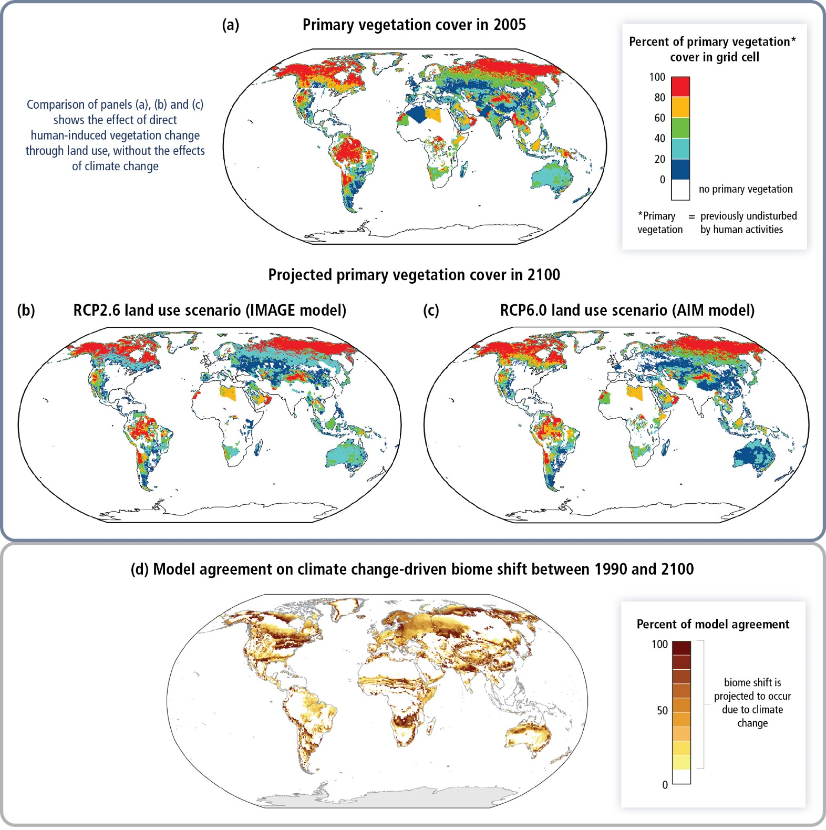

Slide 6
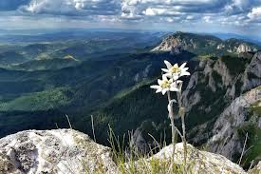
Impacts of Climate
Changing temperatures, precipitation and atmospheric composition affect plants and animals
The specialised are likely to loose, as are the marginalised

Slide 7
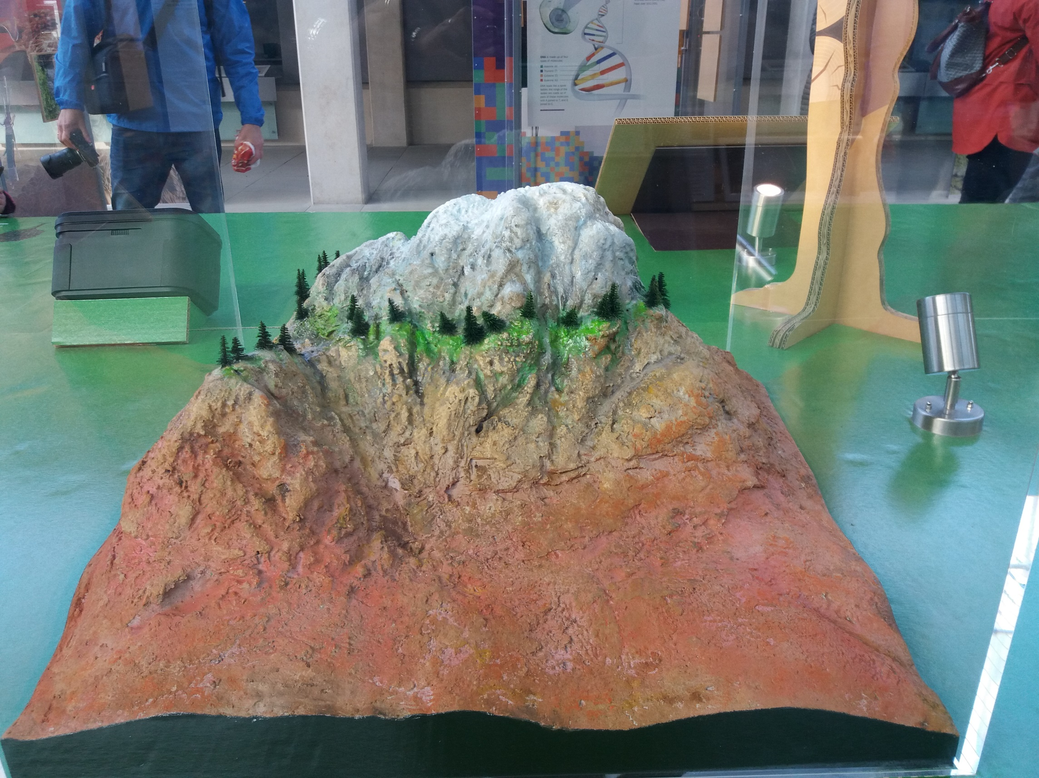
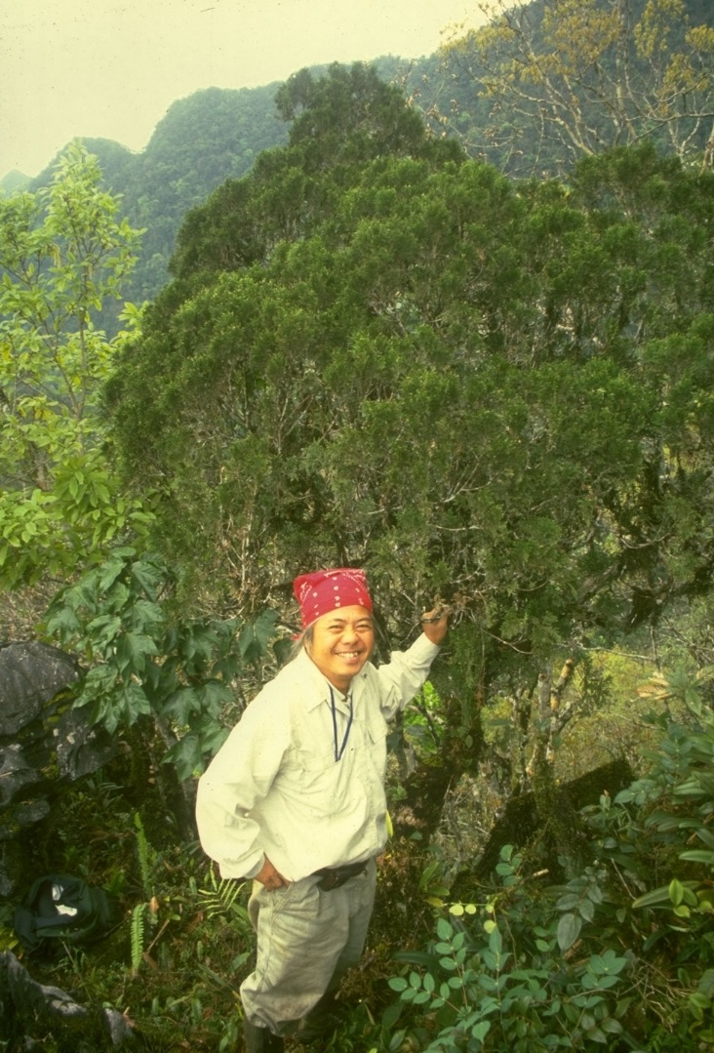
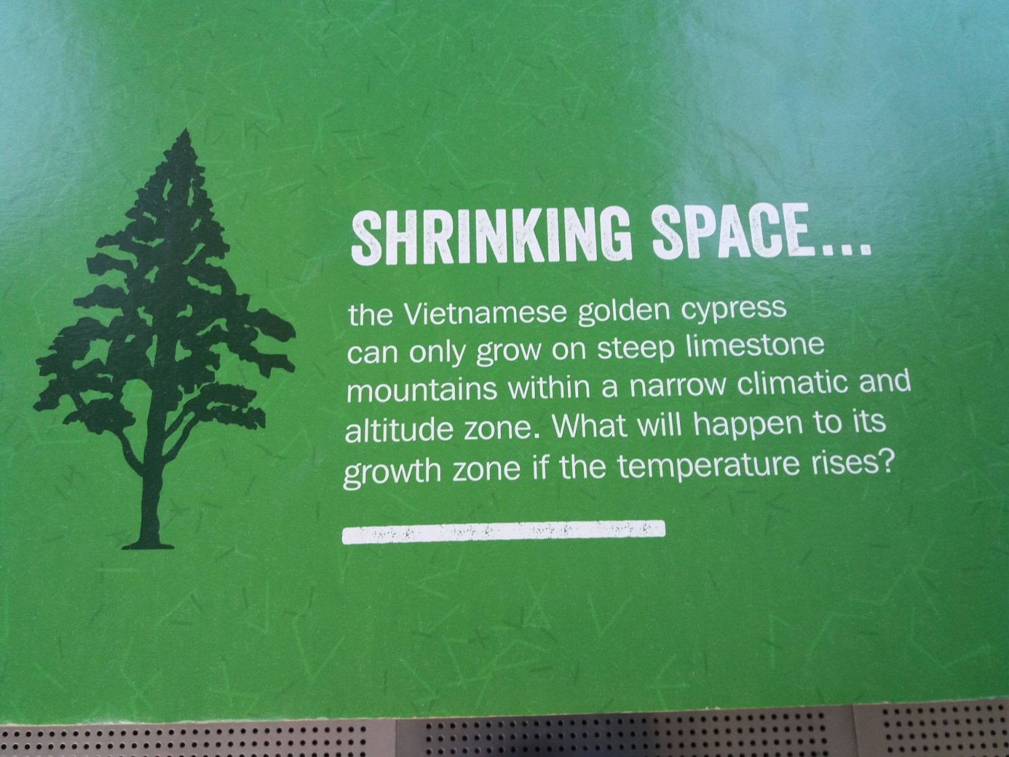

Slide 8
Impacts of Climate
Changing temperatures, precipitation and atmospheric composition affect plants and animals, both in managed and in unmanaged systems
The specialised are likely to loose, as are the marginalised

Slide 9
Impacts and Adaptation
Impact and adaptation
Nature
Agriculture
Dumb farmers?
Maladaptation
Water
How to adapt
Heat stress
Public v private adaptation
Sea level rise
Valuation
Recap
WTP v WTAC
Benefit transfer

Slide 10
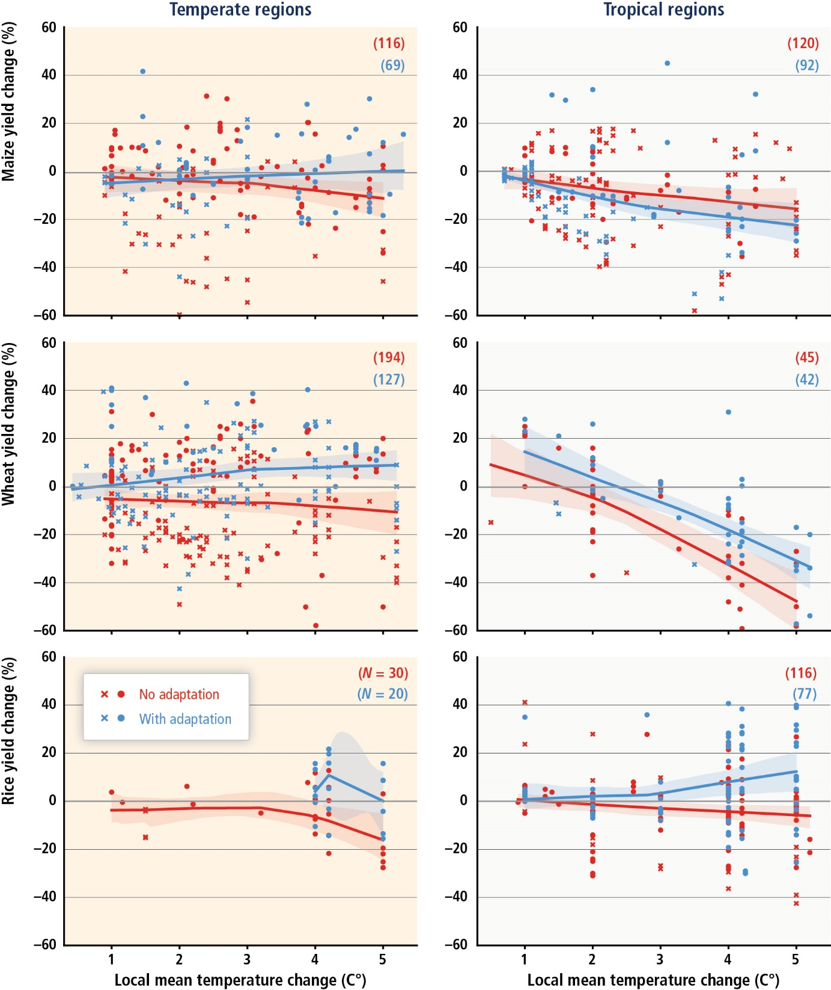

Slide 11
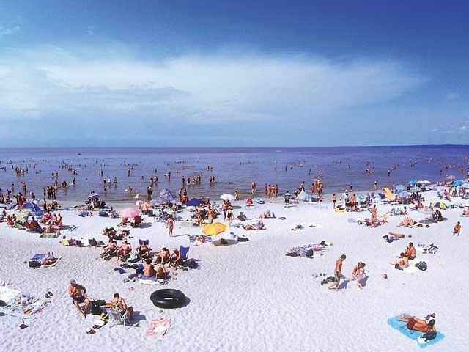
The Gruenspecht Rule of Adaptation

Slide 13
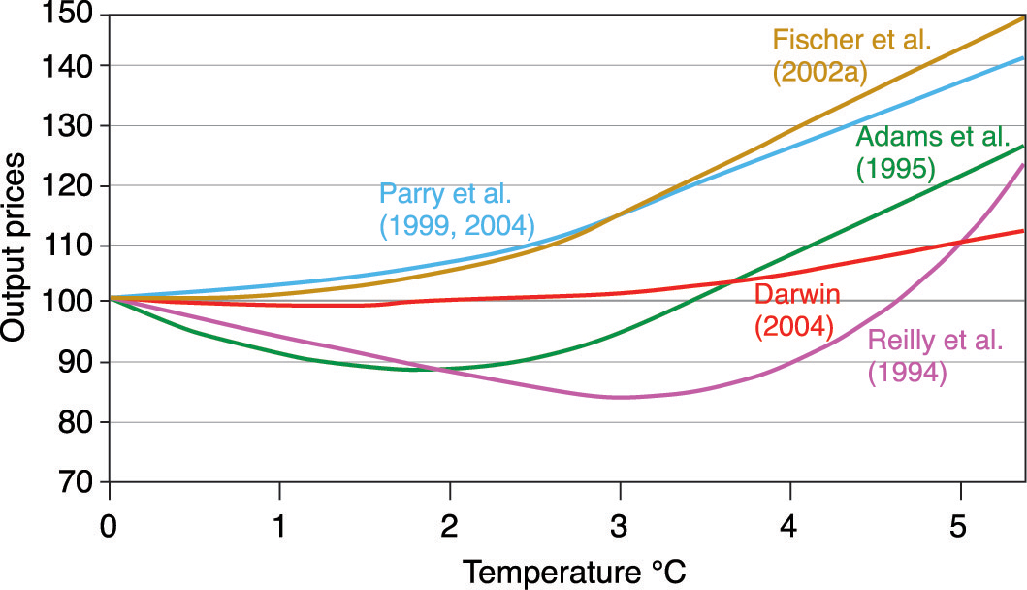

Slide 14
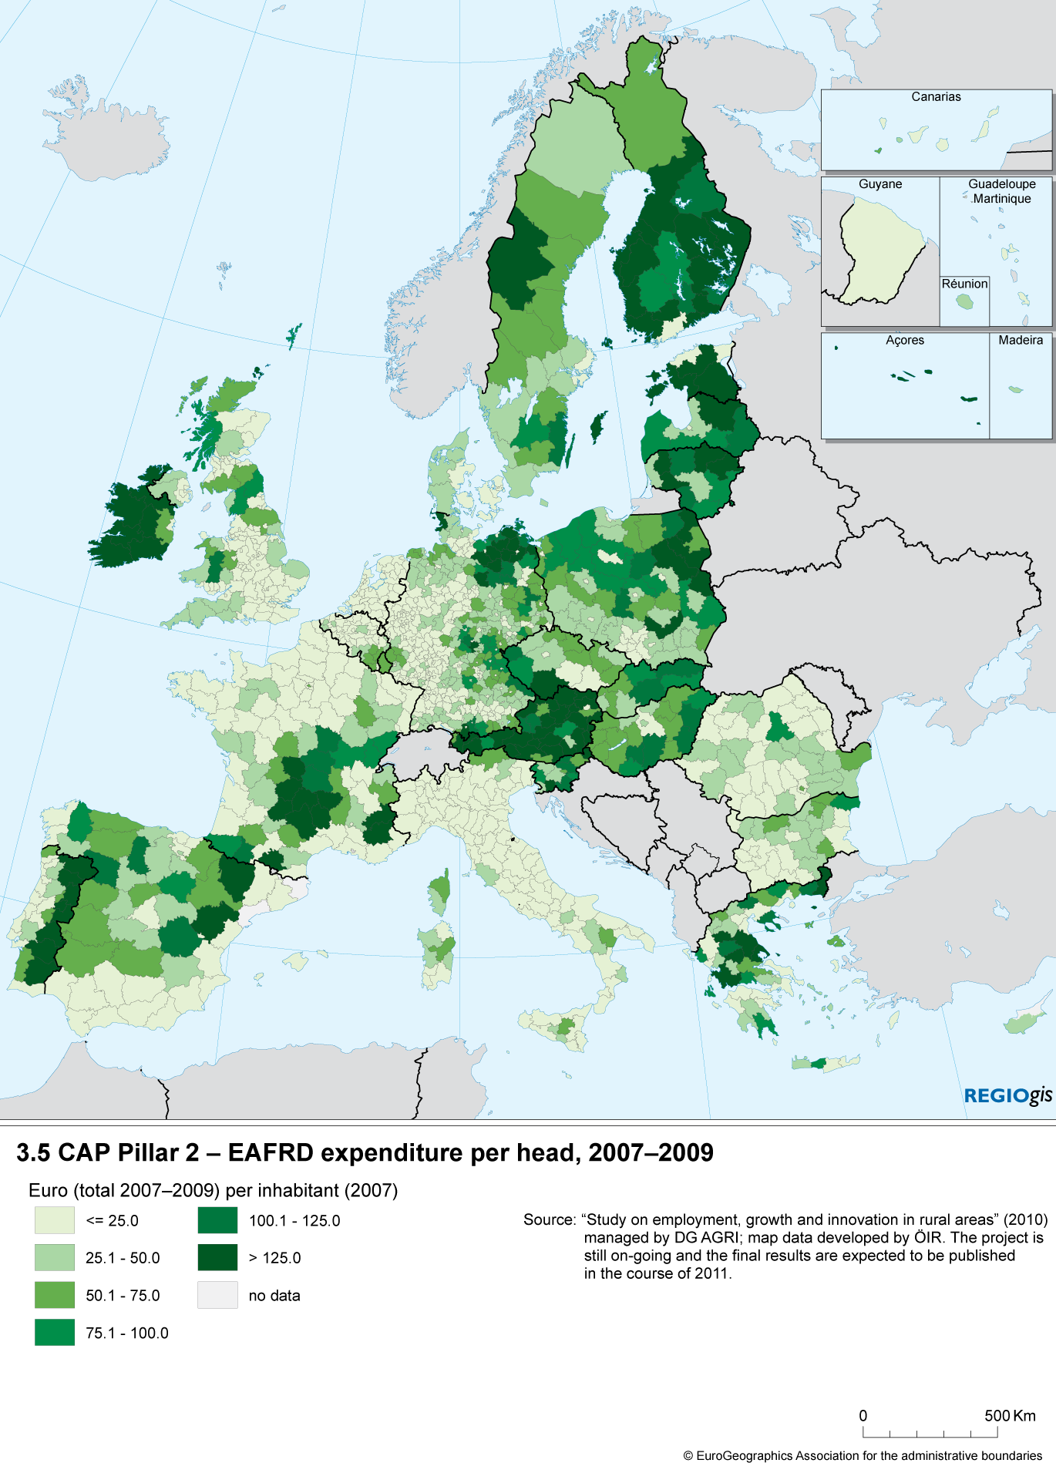
Public maladaptation
The subsidies for agriculture in Europe have two purposes
Reduce regional differences
Shield farmers from market volatility
Trade policy shield farmers from foreign competition
This locks farmers into their current crop choices and management practices

Slide 15
Impacts and Adaptation
Impact and adaptation
Nature
Agriculture
Dumb farmers?
Maladaptation
Water
How to adapt
Heat stress
Public v private adaptation
Sea level rise
Valuation
Recap
WTP v WTAC
Benefit transfer

Slide 16
Impacts of Climate
Changing temperatures, precipitation and atmospheric composition affect plants and animals, both in managed and in unmanaged systems
The specialised are likely to loose, as are the marginalised
Climate change affects water (for drinking, irrigation, cooling), droughts and floods

Slide 17
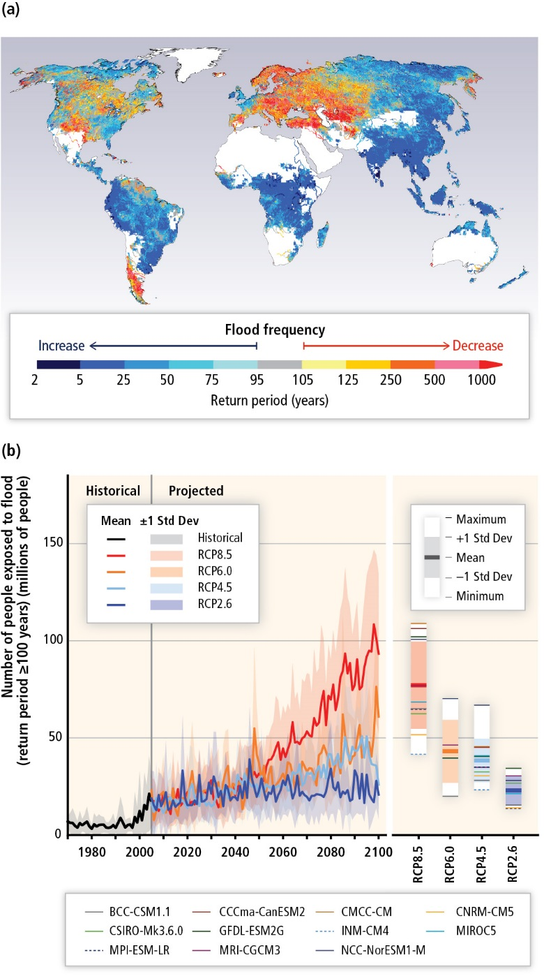

Slide 18
How to adapt?
Uncertainty is a major challenge in adaptation, but it really only matters with long-lived, water-related infrastructure

Slide 21
How to adapt?
Uncertainty is the main challenge in adaptation, and it really only matters with long-lived, water-related infrastructure
If you know that the future will be different, but you don‘t know how, you should be
More robust
More flexible
Elsewhere, systems turn over much faster than climate will change

Slide 22
Impacts and Adaptation
Impact and adaptation
Nature
Agriculture
Dumb farmers?
Maladaptation
Water
How to adapt
Heat stress
Public v private adaptation
Sea level rise
Valuation
Recap
WTP v WTAC
Benefit transfer

Slide 23
Impacts of Climate
Changing temperatures, precipitation and atmospheric composition affect plants and animals, both in managed and in unmanaged systems
The specialised are likely to loose, as are the marginalised
Climate change affects water (for drinking, irrigation, cooling), droughts and floods
Climate change affects energy production and consumption; tourism; construction; transport; labour productivity and so on

Slide 24
Impacts of Climate -2
Climate change also affects human health, through heat stress (cardiovascular, respiratory), cold stress (cardiovascular), vector-borne diseases (malaria, dengue fever, schistosomiasis), other infectuous diseases (cholera), water and food quantity and quality, air pollution, and extreme weather events
Sea level rise leads to land loss and higher costs for coastal protection, wetland loss, saltwater intrusion

Slide 25
Public v private adaptation
During a heat wave, you should
Wear little clothes
Stay calm
Keep out of sun
Drink lots (but no alcohol)
Some adaptation is collective: Siestas and late dinner make physiological sense in hot places
At best, the government should run a heat awareness and preparedness campaign
During the 2003 heat wave in France, many people died because of public failures

Slide 26
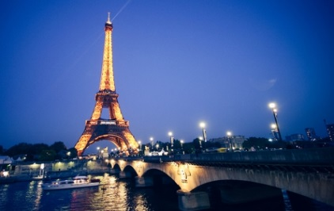
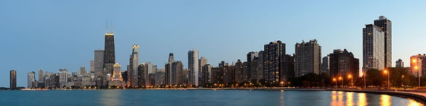
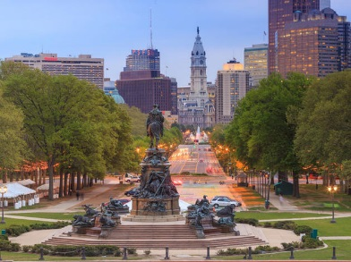
Public v private adaptation -2
During the 2003 heat wave in France, many people died because of public failures
Medical professionals were on holiday, and there was no procedure for calling them back
Shopping malls are air-conditioned; security personnel removed people seeking relief from the heat
In crime-ridden areas, people were afraid to open their windows
Poor people could not afford to turn on their fans
Public intervention complements private adaptation

Slide 27
Impacts and Adaptation
Impact and adaptation
Nature
Agriculture
Dumb farmers?
Maladaptation
Water
How to adapt
Heat stress
Public v private adaptation
Sea level rise
Valuation
Recap
WTP v WTAC
Benefit transfer

Slide 28
Impacts of Climate -2
Climate change also affects human health, through heat stress (cardiovascular, respiratory), cold stress (cardiovascular), vector-borne diseases (malaria, dengue fever, schistosomiasis), other infectuous diseases (cholera), water and food quantity and quality, air pollution, and extreme weather events
Sea level rise leads to land loss and higher costs for coastal protection, wetland loss, saltwater intrusion

Slide 29
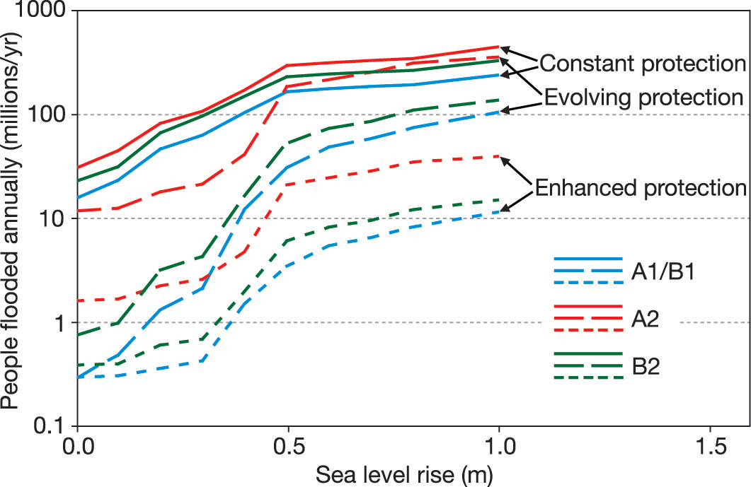

Slide 30
Impacts and Adaptation
Impact and adaptation
Nature
Agriculture
Dumb farmers?
Maladaptation
Water
How to adapt
Heat stress
Public v private adaptation
Sea level rise
Valuation
Recap
WTP v WTAC
Benefit transfer

Slide 31
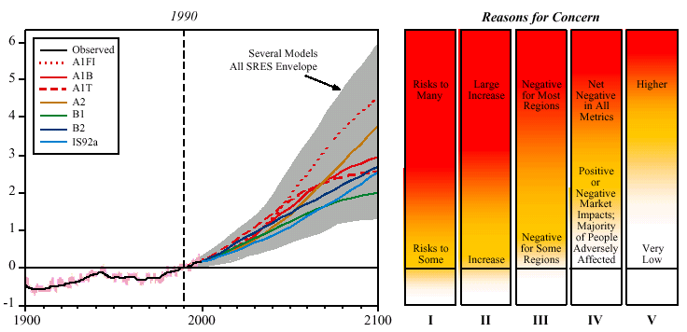
Global mean warming ºC
Year
I Risks to Unique and Threatened Systems
II Risks from Extreme Climate Events
III Distribution of Impacts
IV Aggregate Impacts
V Risks from Future Large-Scale Discontinuities
Source: IPCC 2001

Slide 32
Impacts of Climate
Climate change has many different impacts, with different effects for different countries, sectors, times
If one wants to get insights, high level indicators need to be used
If one wants to compare the impacts of climate change to the impacts of emission reduction, include the impacts in the national accounts, or determine how much compensation should be paid, money is the appropriate indicator

Slide 33
Monetary Valuation
The aim is to express a welfare loss in an equivalent income loss
Revealed preferences
Travel cost
Hedonic pricing
Stated preferences
Contingent valuation
Contingent choice
Each method has its drawbacks, but stated preferences suffer from a range of biases, including unfamiliarity and manipulation

Slide 34
Impacts and Adaptation
Impact and adaptation
Nature
Agriculture
Dumb farmers?
Maladaptation
Water
How to adapt
Heat stress
Public v private adaptation
Sea level rise
Valuation
Recap
WTP v WTAC
Benefit transfer

Slide 35


WTP v WTAC
Willingness to pay, or equivalent variation, is the maximum amount you would be willing to pay to secure a price fall
Willingness to accept compensation, or compensating variation, is the minimum amount you would be willing to accept to forego a price fall
Willig (1976) showed that
This is because of the income effect
He also showed that
This is because of substitution
Result carries over to quantities
$$EV<ΔCS<CV$$
$$EV≈ΔCS≈CV$$

Slide 37
WTP and WTAC -2
Willingness to pay and willingness to accept compensation are different, because
the budget constraint is different
voluntary and involuntary risks are different
people attach value to the status quo

Slide 38
Impacts and Adaptation
Impact and adaptation
Nature
Agriculture
Dumb farmers?
Maladaptation
Water
How to adapt
Heat stress
Public v private adaptation
Sea level rise
Valuation
Recap
WTP v WTAC
Benefit transfer

Slide 39
Benefit transfer
Valuation is difficult and expensive
Therefore, estimated values are extrapolated (benefit transfer) from one place to the next and from one case to the next
As values are highly context-specific, this introduces all sorts of uncertainties, which are not well-understood

Slide 40
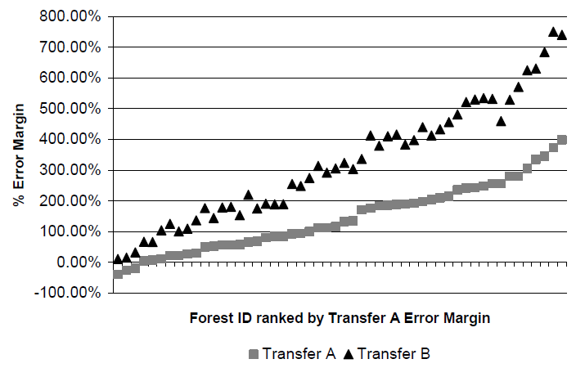

Slide 41
Area | Error (%)
Sport fishing | 5-40
 | 5-15
Water quality improvements | 4-34
 | 1-75
Water-based recreation | -
 | 1-475
Water quality improvements | 25-45
 | 18-41
Saltwater fishing | 1-34
 | -
White water rafting | 24-56
 | 6-228
Biodiversity on agricultural land | 27-36
 | 22-44

